Slide 1

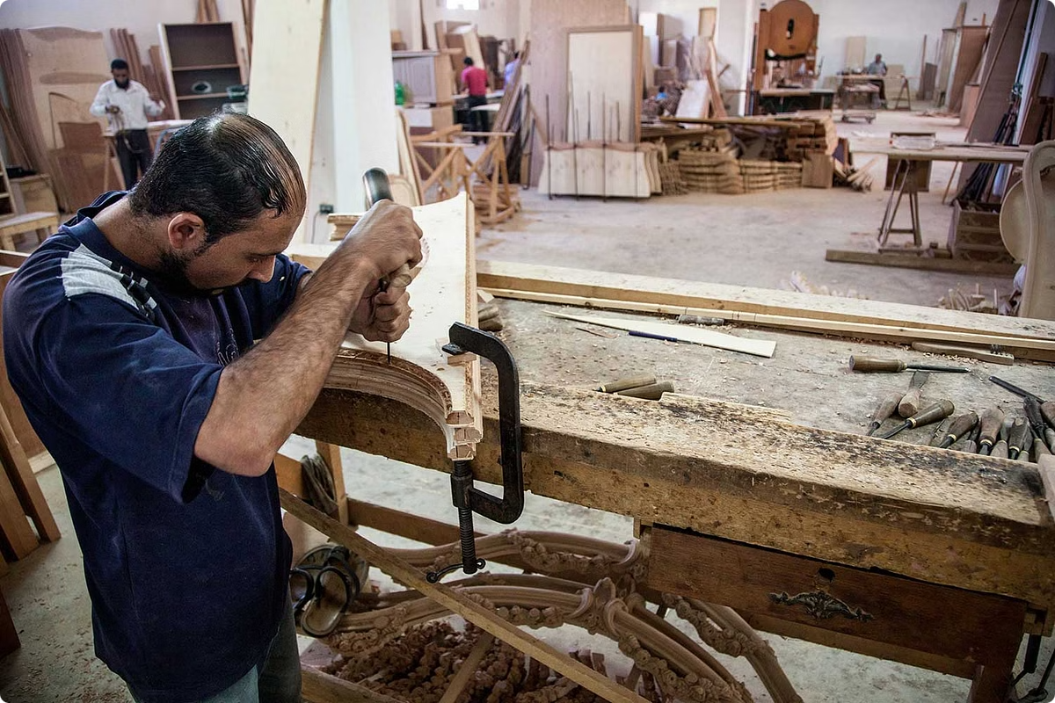
An Online Gateway for Furniture from Damietta
The Digital Egypt Pioneer Initiative aims to establish an online marketplace that showcases the exquisite and renowned furniture crafted in the historic city of Damietta. This digital gateway will connect local artisans with a global audience, promoting the unique artistry and heritage of this vibrant Egyptian region.

Slide 2

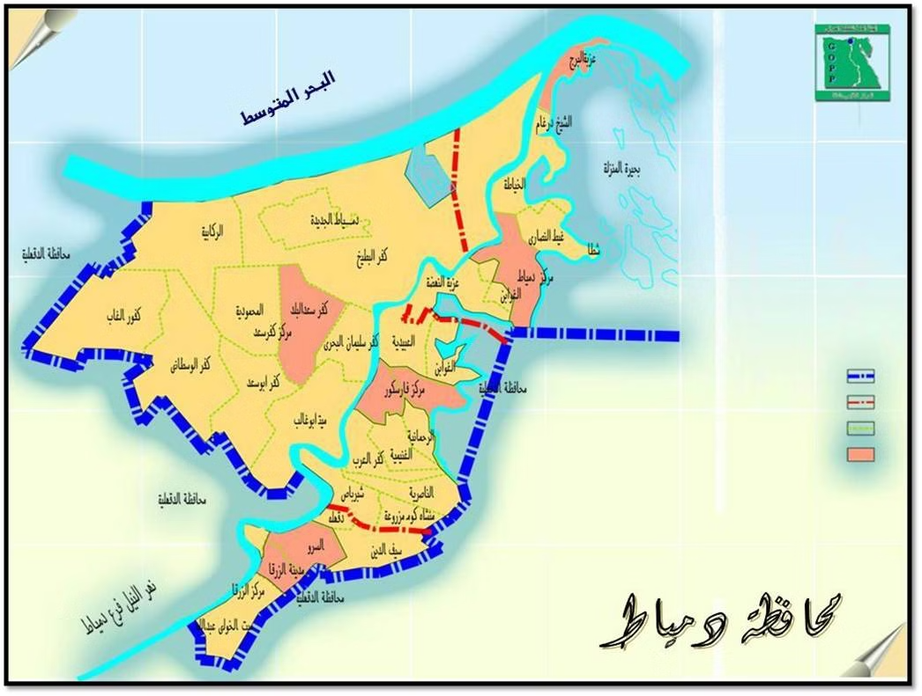
Problem and Solutions
1
Limited Market Reach
2
Digital Transformation
Damietta's furniture craftsmen often struggle to expand beyond their local customer base due to lack of exposure and access to wider markets.
The online platform will empower artisans to showcase their work globally, leveraging the power of digital technologies to overcome geographical barriers.
3
Preserving Heritage
By promoting Damietta's unique furniture designs, the initiative aims to safeguard the region's rich cultural heritage and traditional craftsmanship.

Slide 3
Why This Project?
Economic Impact
Cultural Preservation
Global Visibility
The online platform will create new revenue streams for local furniture makers, boosting the economic prosperity of the Damietta region.
By showcasing Damietta's distinctive furniture designs, the initiative will help preserve the area's rich cultural heritage and artisanal traditions.
The online gateway will provide Damietta's furniture makers with unparalleled access to international markets, expanding their customer base exponentially.

Slide 4

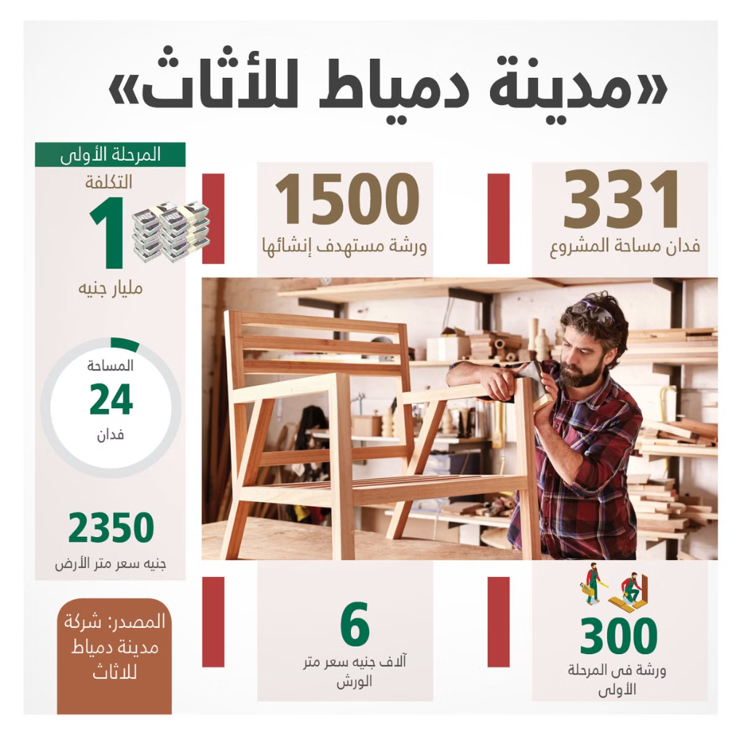
The Goal of the Project
Digital Transformation
Economic Prosperity
Empower Damietta's furniture artisans to embrace digital technologies and reach a global customer base.
Increase revenue and job opportunities for local craftspeople, driving economic growth in the Damietta region.
Cultural Preservation
Collaborative Ecosystem
Showcase and preserve the distinctive furniture designs and traditional craftsmanship of Damietta.
Foster a collaborative environment where artisans, designers, and market experts work together to enhance the project's impact.

Slide 5
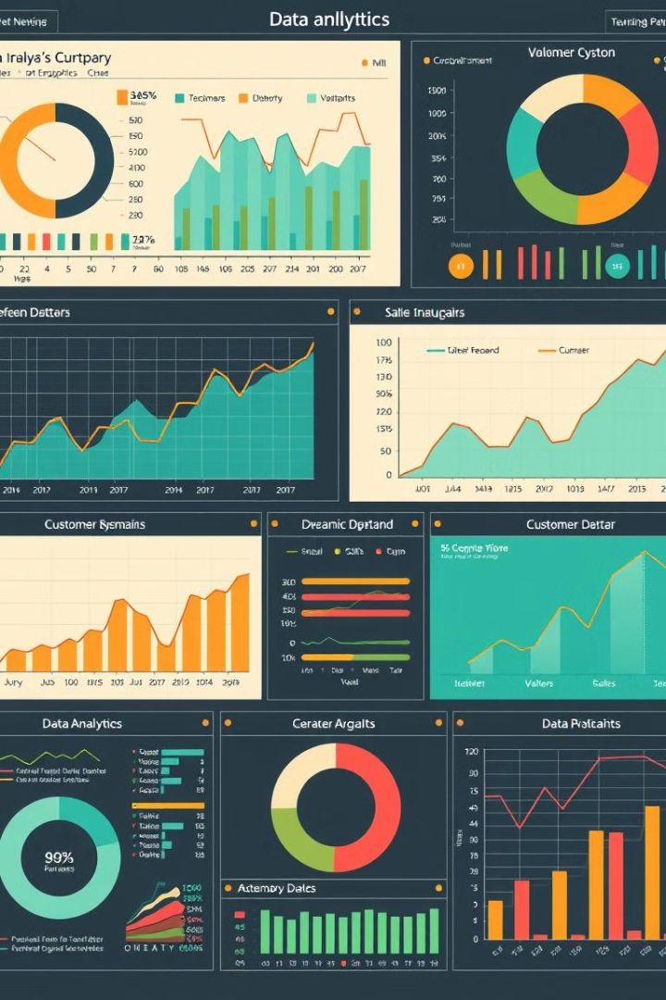
Feasibility Study
1
Market Analysis
Comprehensive study of global and regional demand for high-quality, handcrafted furniture.
2
Digital Infrastructure
Assessment of the technological capabilities and readiness of Damietta's furniture artisans.
3
Financial Viability
Detailed projections on the potential revenue and cost-effectiveness of the online platform.

Slide 6
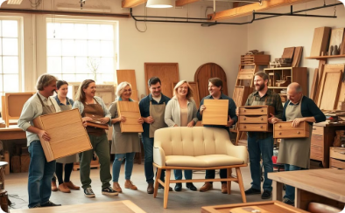
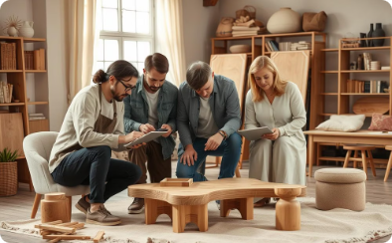
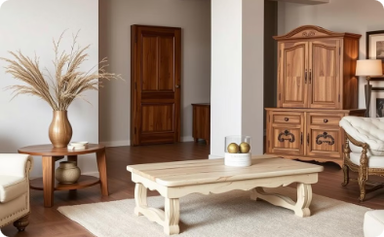
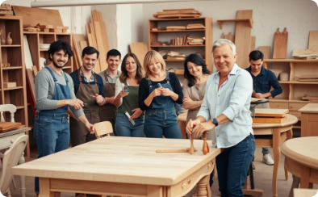
Anticipated Outcomes
Increased Revenue
Collaborative Ecosystem
Cultural Heritage
Employment Opportunities
Expanded customer base and enhanced sales opportunities for Damietta's furniture makers.
Increased global awareness and appreciation for Damietta's unique furniture designs and craftsmanship.
Fostering partnerships between artisans, designers, and market experts to drive innovation.
New job creation and sustainable livelihoods for the local furniture artisan community.

Slide 7





Project Completion and Software Development Lifecycle
Requirement Gathering
A collaborative process involving stakeholders to define project goals and user needs.
Design and Prototyping
Creating wireframes, mockups, and prototypes to visualize the platform's user interface and functionality.
Development and Testing
Building the software, conducting unit testing, and ensuring code quality.
Deployment and Launch
Launching the platform and making it available to users.
Maintenance and Support
Providing ongoing support, updates, and improvements to the platform.

Slide 8








Cutting-Edge Tech Stack for Furniture E-commerce
React.js
Tailwind CSS
Node.js
Express.js
Powerful JavaScript library for building dynamic and responsive user interfaces.
Utility-first CSS framework for rapidly building custom, responsive user interfaces.
Robust runtime environment for executing JavaScript on the server-side, enabling seamless backend integration.
Minimalist web application framework for Node.js, streamlining server-side logic and API development.
TypeScript
MongoDB
Git & GitHub
Figma
Superset of JavaScript that adds static typing, improving code maintainability and developer productivity.
Flexible NoSQL database for storing and managing product data, customer information, and other e-commerce essentials.
Popular platform for hosting and managing Git repositories, enabling code sharing, collaboration, and project management.
Industry-standard design tool for creating user interfaces and prototypes, facilitating visual collaboration and design iteration.

Slide 9
Key Features
User Registration and Profile Management - Customers can create accounts, manage their profiles, store shipping addresses, and maintain wishlists of favorite products.
Product Catalog - Furniture organized by categories, styles, materials, colors, and brands, with powerful search, detailed product pages, and 360-degree product views.
Shopping Cart and Checkout - Add-to-cart functionality, secure checkout process with multiple payment options, guest checkout, and order tracking.
Inventory Management - Real-time stock updates, display of availability and estimated delivery times.
Promotions and Discounts - Apply discount codes during checkout. Display ongoing sales, discounts, or seasonal promotions.
Mobile Optimization - Ensure the website is fully responsive and works seamlessly across mobile devices

Slide 10
In progress Features
Admin Panel - Manage orders, products, inventory, and customers from an easy-to-use backend.
Blog/Content Section - Articles on interior design trends, how-to guides, and furniture care tips.
Loyalty and Referral Programs - Customers earn points for purchases that can be redeemed on future purchases. Customers can refer friends to earn discounts.
Reviews and Ratings - Customer reviews and ratings to help users make informed purchase decisions.
Personalization and Customization - Option for users to customize furniture items (color, size, material) based on their needs. Room Planner Tool: Allow customers to see how furniture fits into their space by offering augmented reality or room planning software.
Shipping and Delivery - Shipping cost calculator, multiple delivery options, ability to choose preferred delivery date and time.
Customer Support - Live Chat: To assist customers in real-time. FAQs: Common questions about shipping, returns, and product care. Contact forms and email
Returns and Refunds - Easy-to-access return policy information. A return request system for customers to initiate returns or exchanges.

Slide 11
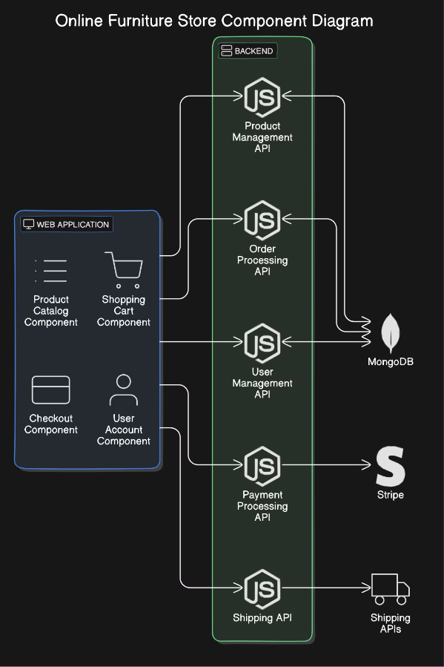

Slide 12
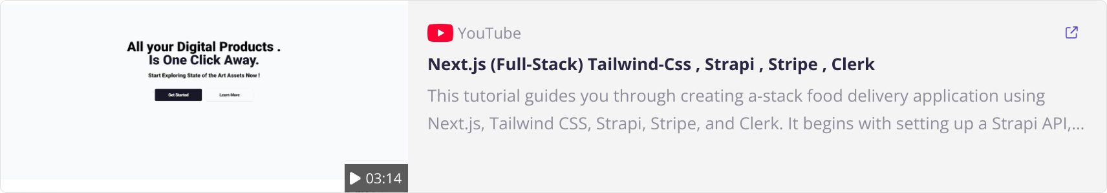
The Demo

Slide 13



The Team
Youstina
Mariam
Rawan
Asma
Member
Member
Member
Member
Mahmoud
Team Leader

Slide 14


Acknowledgments and Gratitude
The Digital Egypt Pioneer Initiative would like to express its deepest gratitude to the President of Egypt and the Ministry of Trade and Industry for their unwavering support and commitment to empowering local artisans and promoting the rich cultural heritage of Damietta.

Slide 15

Appreciation for the President and the Ministry
We are immensely grateful for the President's and the Ministry's endorsement of this transformative initiative. Their visionary leadership and dedication to fostering economic growth and cultural preservation in Egypt have been instrumental in driving the success of the Digital Egypt Pioneer Initiative.

Slide 16

Thanks and Any Questions
We appreciate your time and attention today. Please feel free to ask any questions you may have about the Digital Egypt Pioneer Initiative and our plans for the online furniture gateway from Damietta.

